Slide 1
Take it. Easy!
CSYE6200 OOD- Android Ordering App
Group# 1 Northeastern University
Members： Bowen Zhang， Yi Liu， Yash Khopkar， Punith Narayan

Slide 2
Northeastern University
Motivation & Introduction
1
CONTENTS
4
Server Part
UML
2
5
App Running
Client Part
3

Slide 3
Northeastern University
1
MOTIVATION & INTRODUCTION

Slide 4
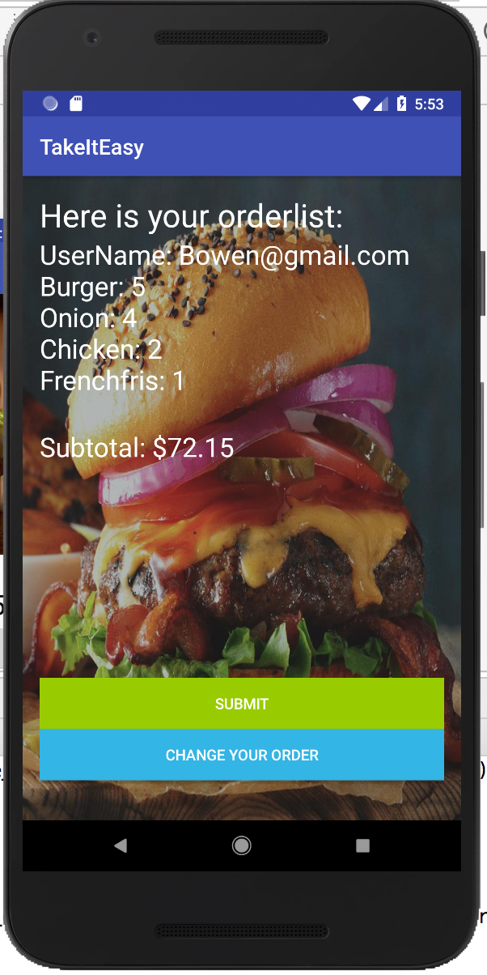
1
MOTIVATION & INTRODUCTION
Northeastern University
Take it, Easy! is the Android App of ordering food.
The advantage of the Android application:
- Mobile application is convenient to carry
- Global partnerships and large install base
- Powerful development framework
- Open marketplace for distributing apps
Customer can order food online and pick up within one hour !

Slide 5
PPT模板下载：www.1ppt.com/moban/ 行业PPT模板：www.1ppt.com/hangye/
节日PPT模板：www.1ppt.com/jieri/ PPT素材下载：www.1ppt.com/sucai/
PPT背景图片：www.1ppt.com/beijing/ PPT图表下载：www.1ppt.com/tubiao/
优秀PPT下载：www.1ppt.com/xiazai/ PPT教程： www.1ppt.com/powerpoint/
Word教程： www.1ppt.com/word/ Excel教程：www.1ppt.com/excel/
资料下载：www.1ppt.com/ziliao/ PPT课件下载：www.1ppt.com/kejian/
范文下载：www.1ppt.com/fanwen/ 试卷下载：www.1ppt.com/shiti/
教案下载：www.1ppt.com/jiaoan/ PPT论坛：www.1ppt.cn
Northeastern University
2
UML

Slide 6
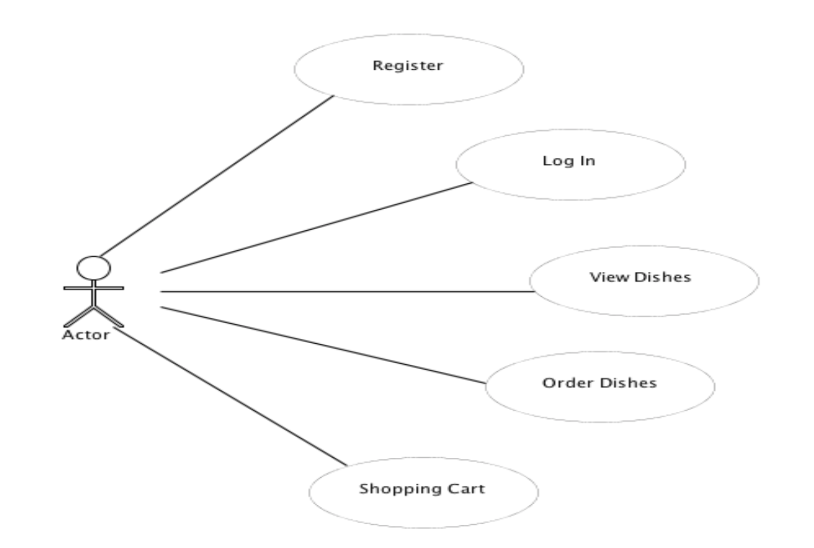
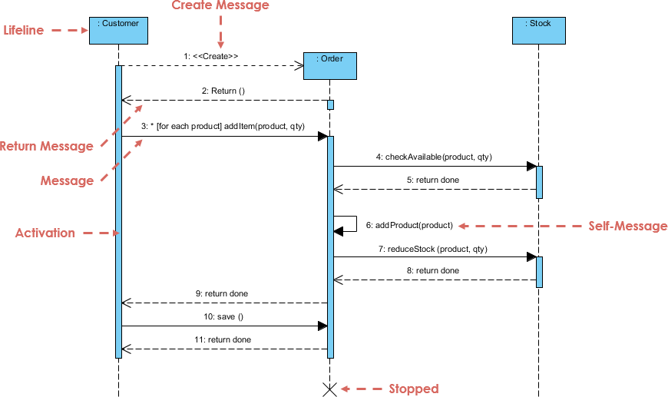
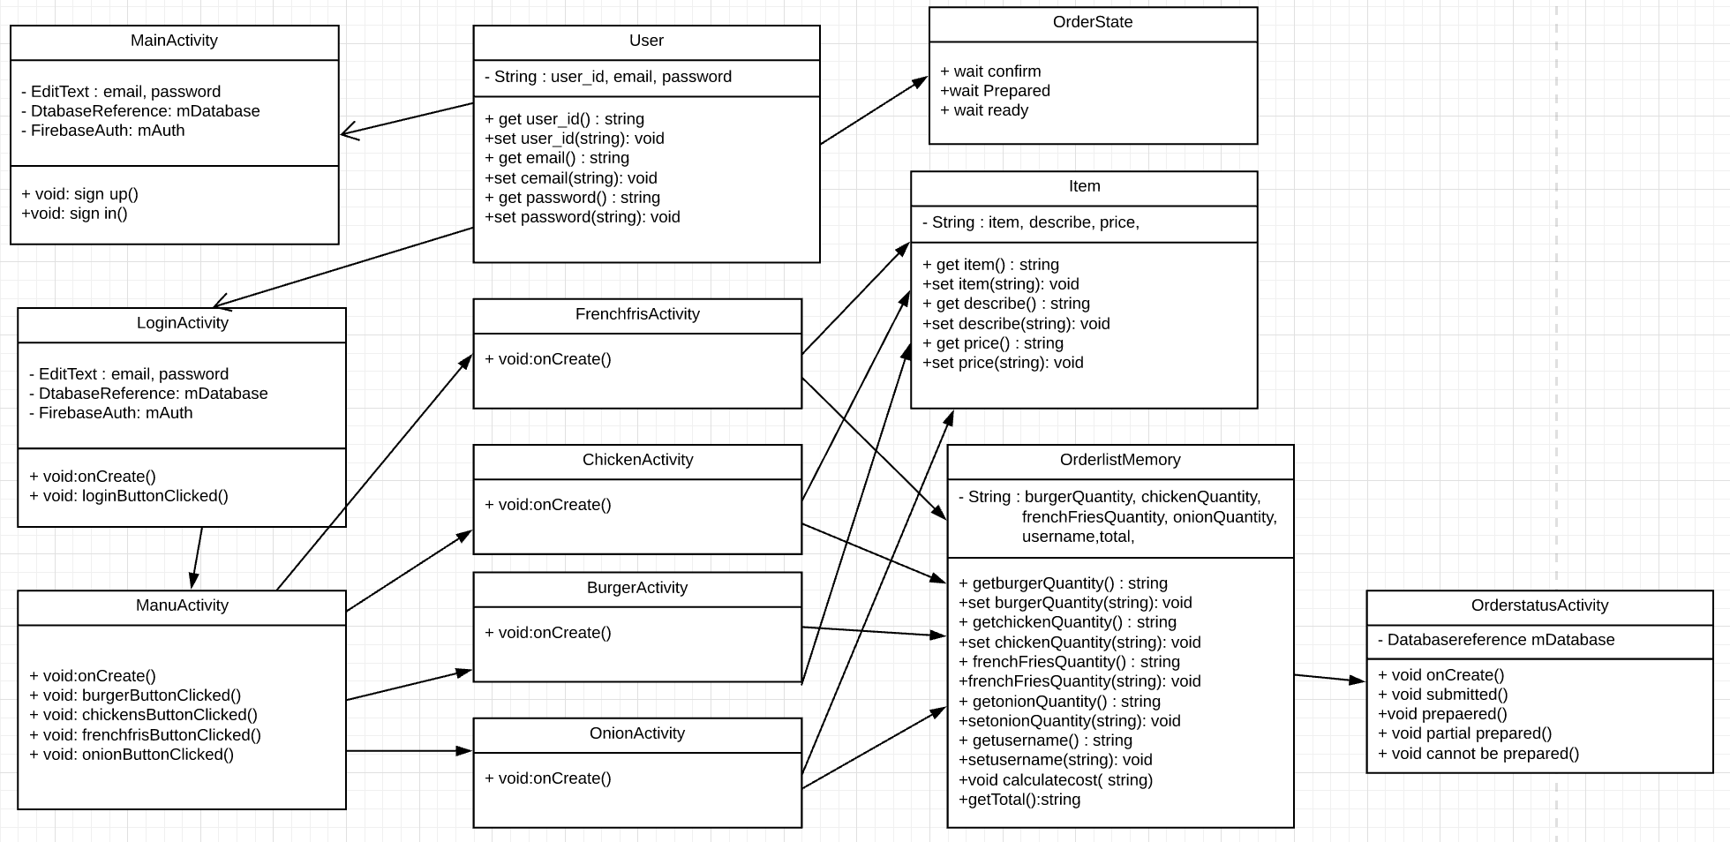
2
UML
Northeastern University

Slide 7
Northeastern University
3
CLIENT PART

Slide 8
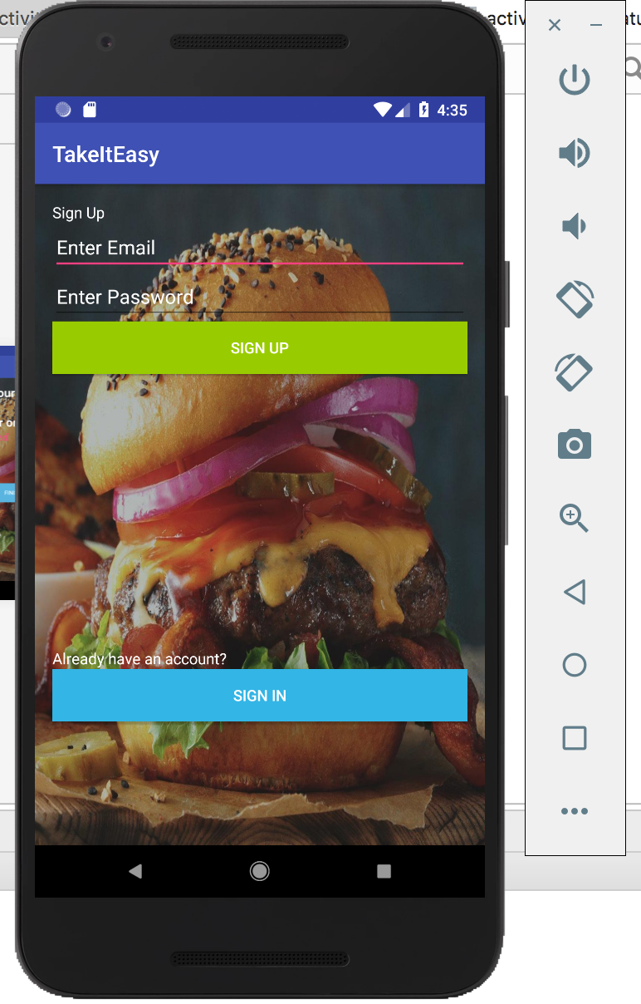

3
CLIENT PART
Northeastern University
Sign up.
Log in.
Menu
Place order.
Change order.

Slide 9
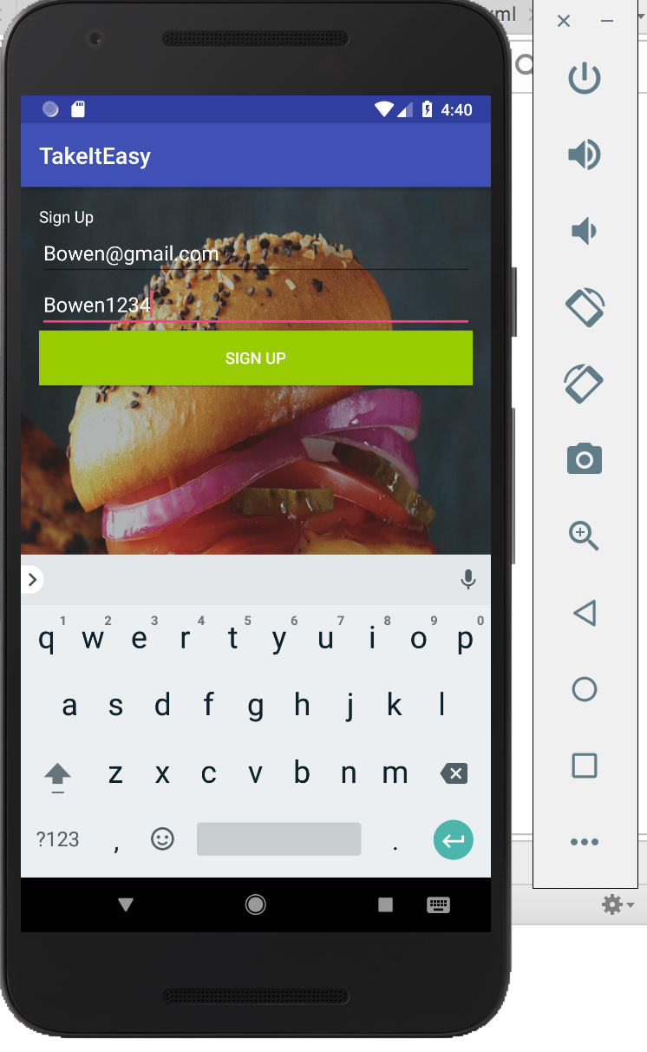
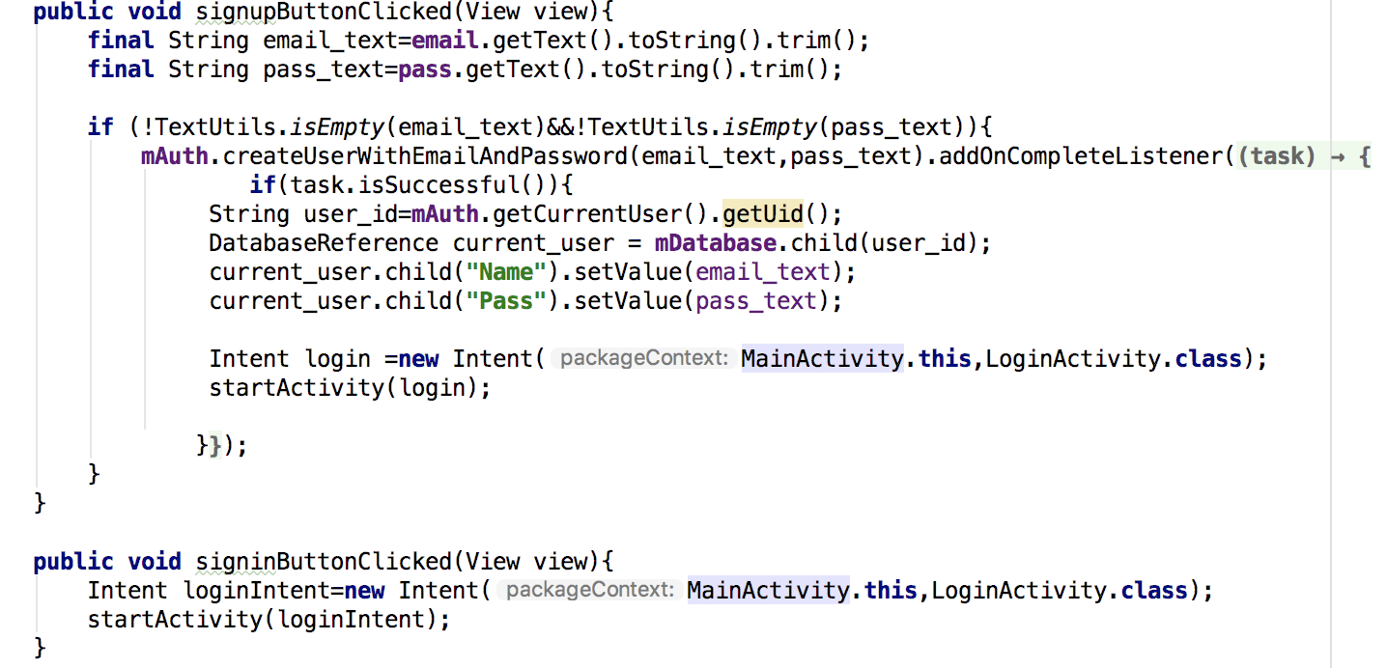
3
CLIENT PART - Sign up
Northeastern University
1) Sign Up:

Slide 10
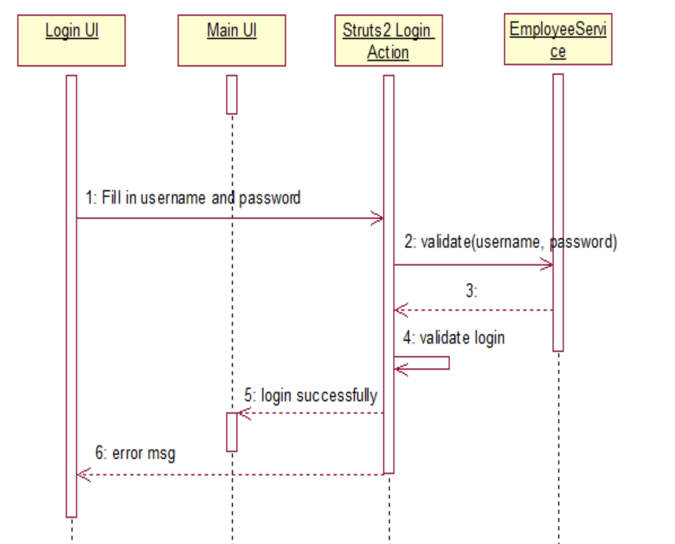
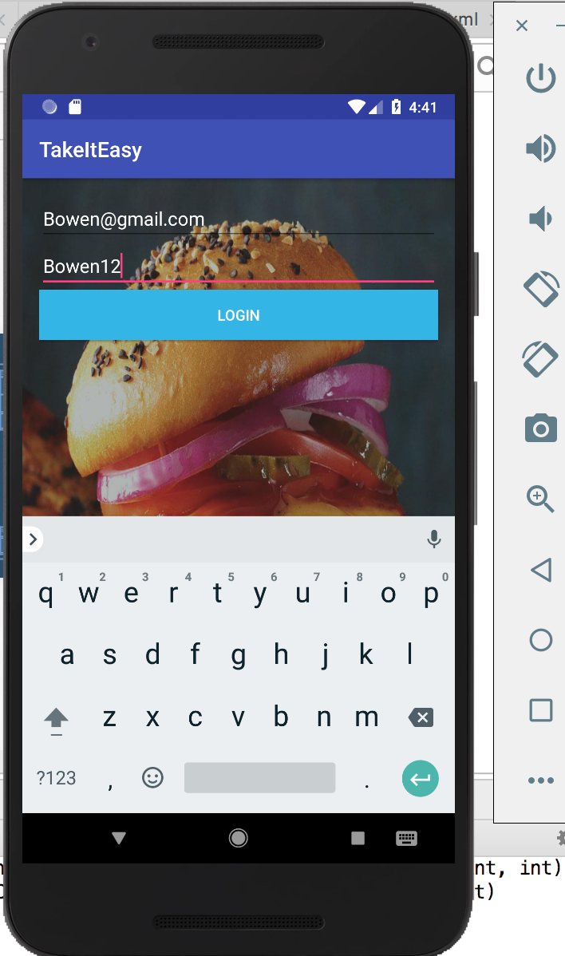
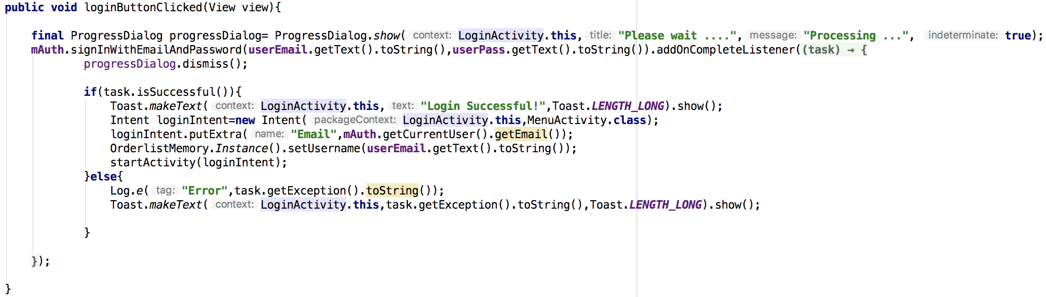
3
CLIENT PART – Log in
Northeastern University
2) Log In:

Slide 11
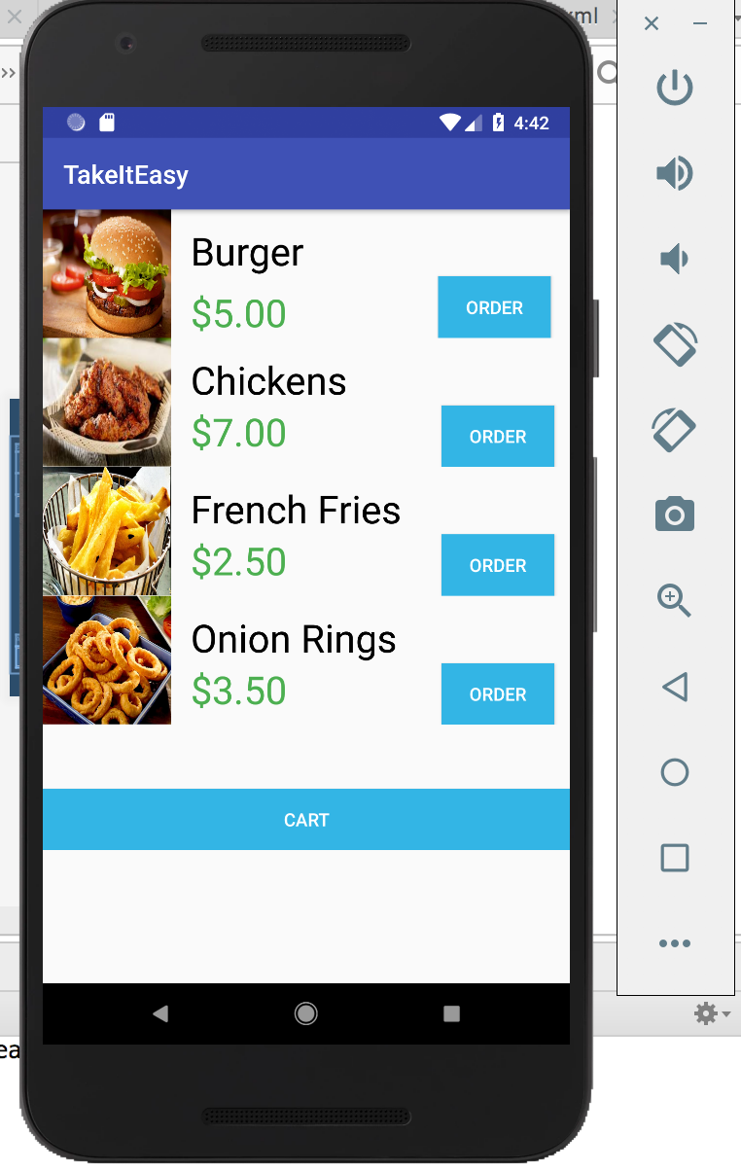
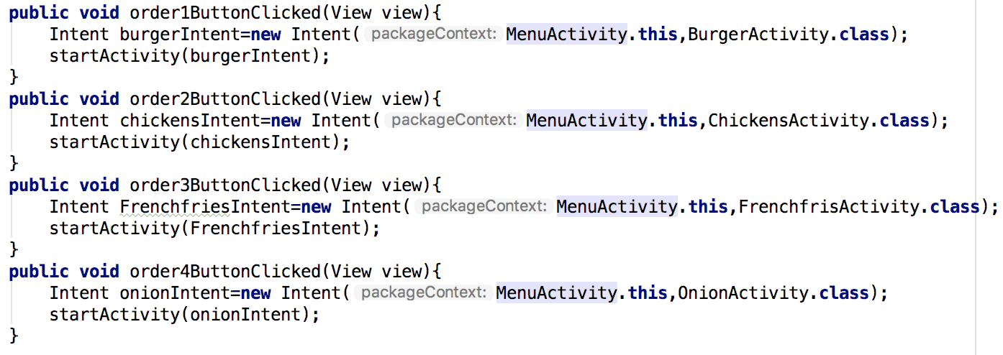
3
CLIENT PART - Menu
Northeastern University
3) Menu:

Slide 12
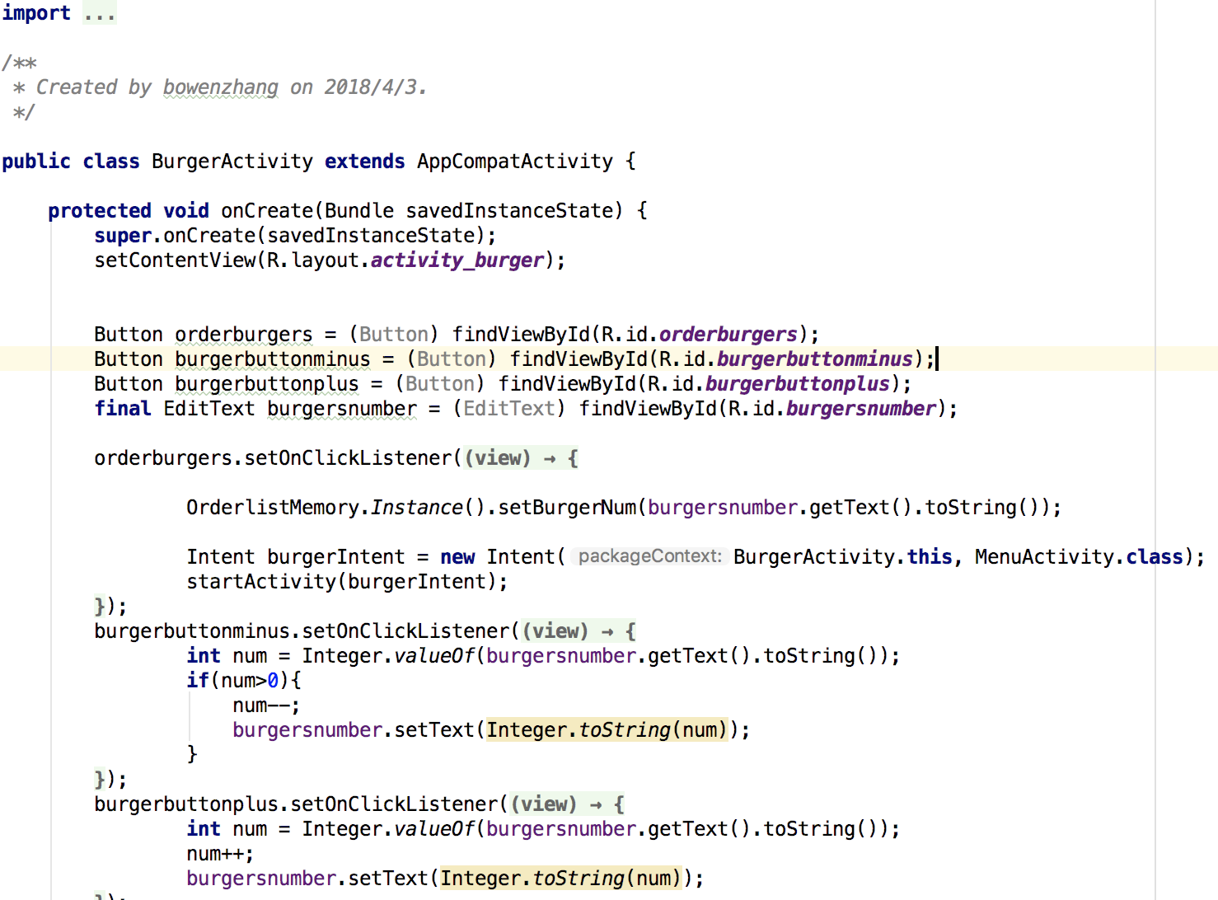
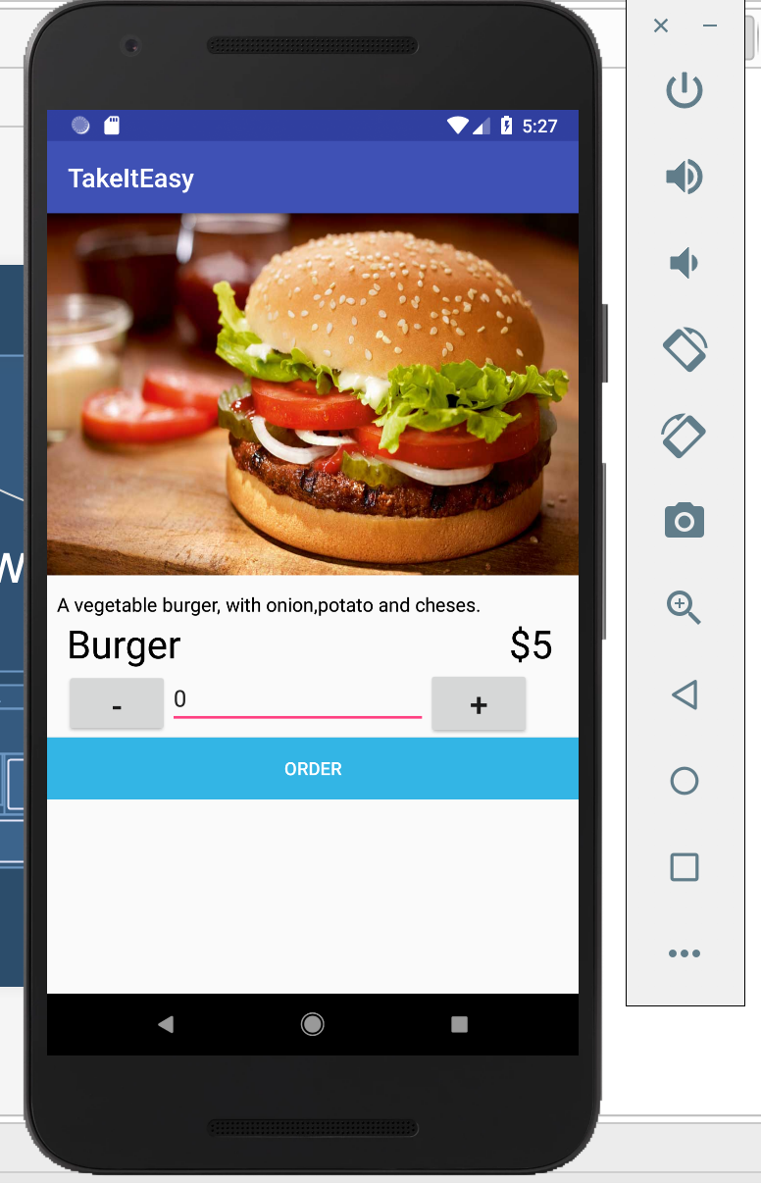
3
CLIENT PART – Place order
Northeastern University
4) Start To Place Order:

Slide 13
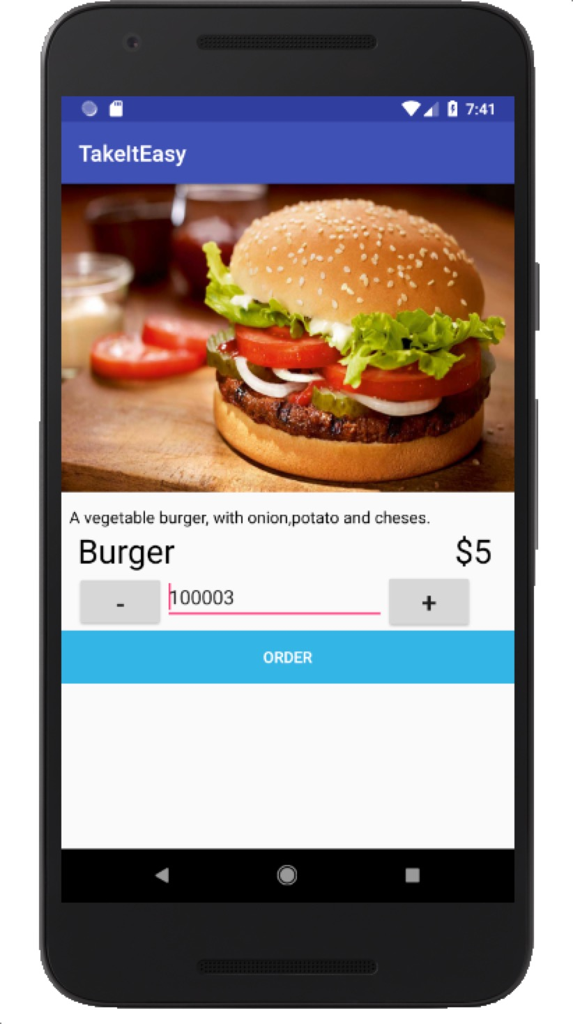
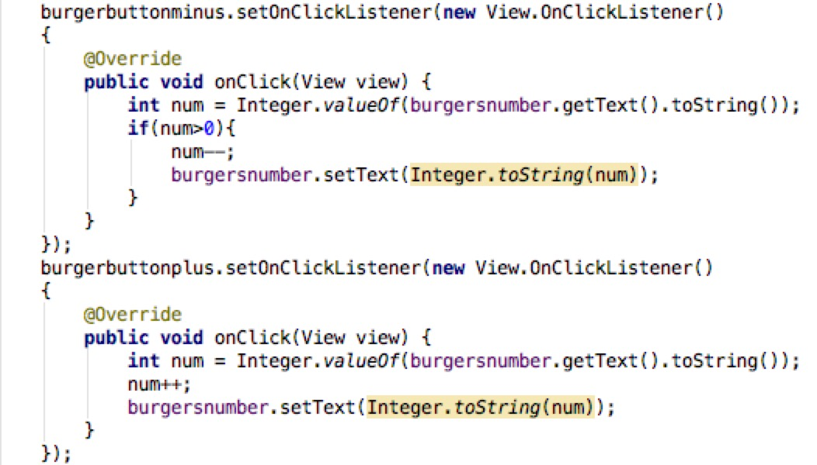
3
CLIENT PART – Place order
Northeastern University
4) Start To Place Order:
Input the number directly
2. Click the button to add or minus
Get the value from the text and change the type to integer
Display the new value in the textview

Slide 14
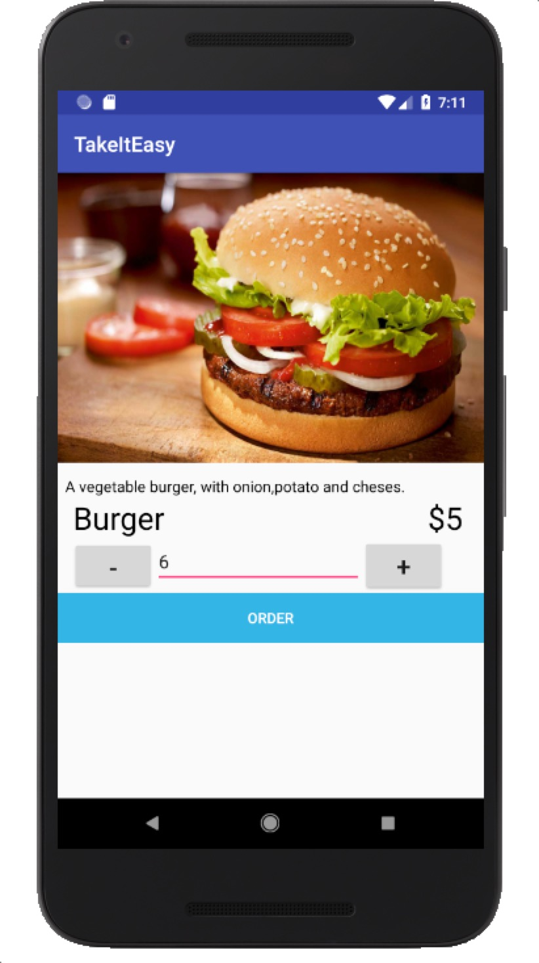
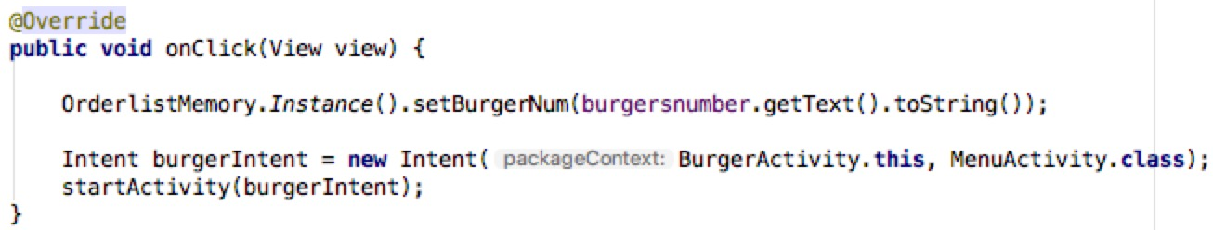
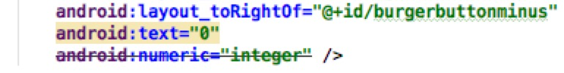
3
CLIENT PART – Place order
Northeastern University
4) Start To Place Order:
Click “ORDER” button to proceed to the next step
I created a class to save the quantity for each item.
In case the user enters a decimal
Change the layout .xml file numeric text to “integer”.

Slide 15
3
CLIENT PART – Place order
Northeastern University
BurgerActivity
+set burgerquantity
OrderlistMemory
-String: BurgerNum; ChickenNum; FrenchfriesNum; OnionNum; Username; Total;
+getUsername():String +setUsername():void +getBurgerNum() :String +setBurgerNum():void +getChickenNum() :String +setChickenNum():void +getFrenchfriesNum() :String +setFrenchfriesNum():void +getOnionNum() :String +setOnionNum():void +getTotal():String +calculatecost():void
ChickensActivity
+set chickensquantity
OrderListActivity
-String: username; : Burgerquantity; Chickenquantity; Frenchfriesquantity; Onionquantity;
+retrieve data() +printdata()
uses
use
FrenchfriesActivity
+set frenchfriesquantity
OnionActivity
+set onionquantity

Slide 16
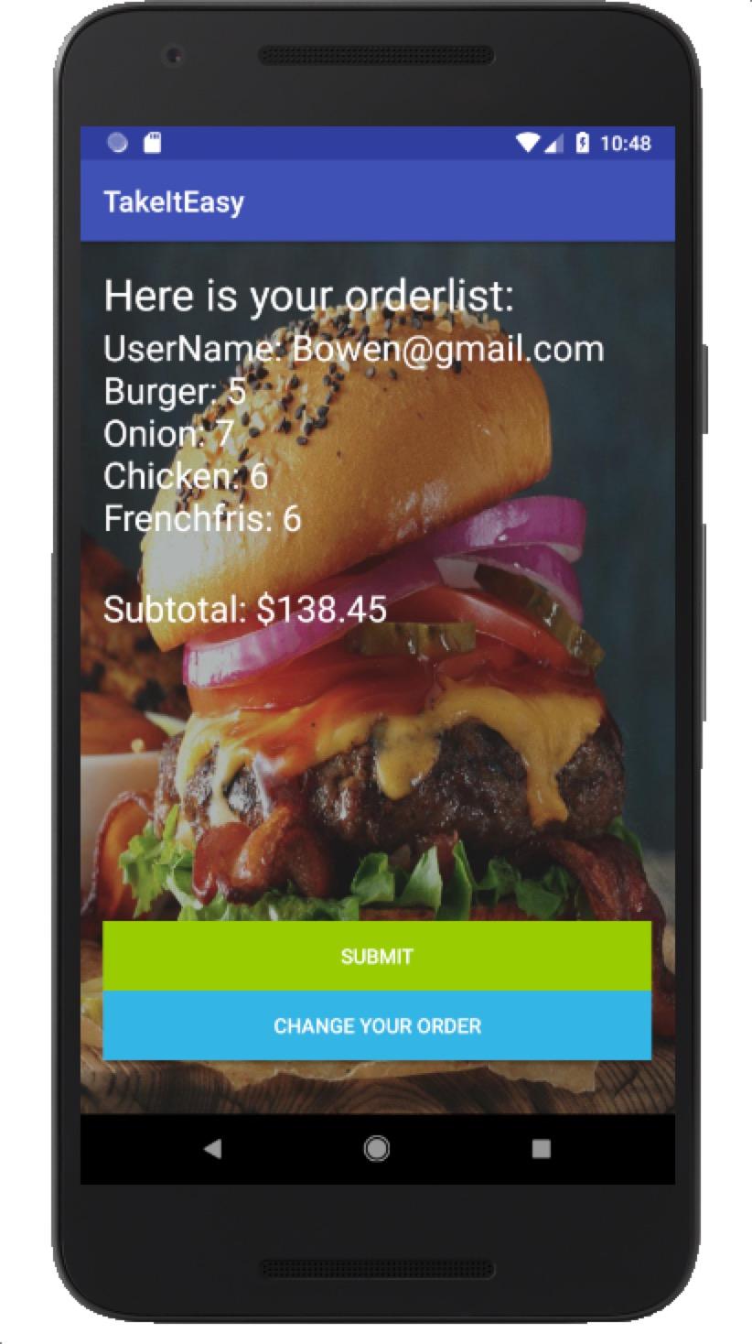
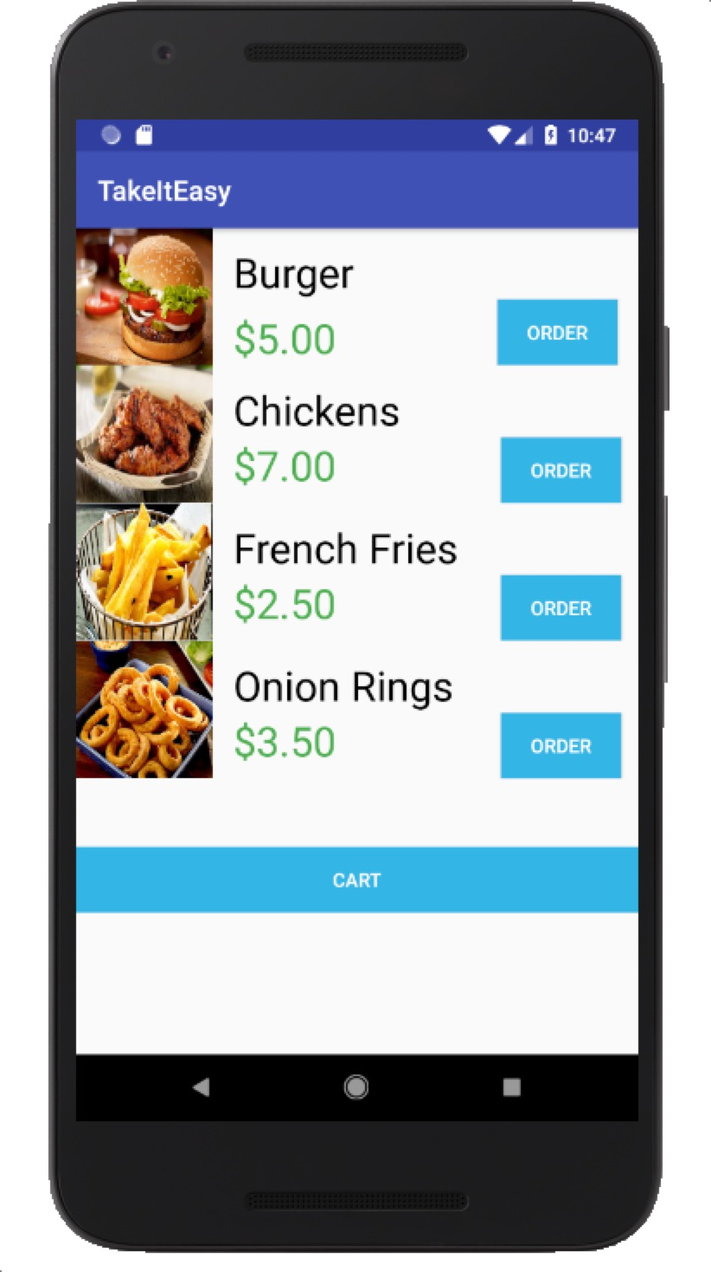
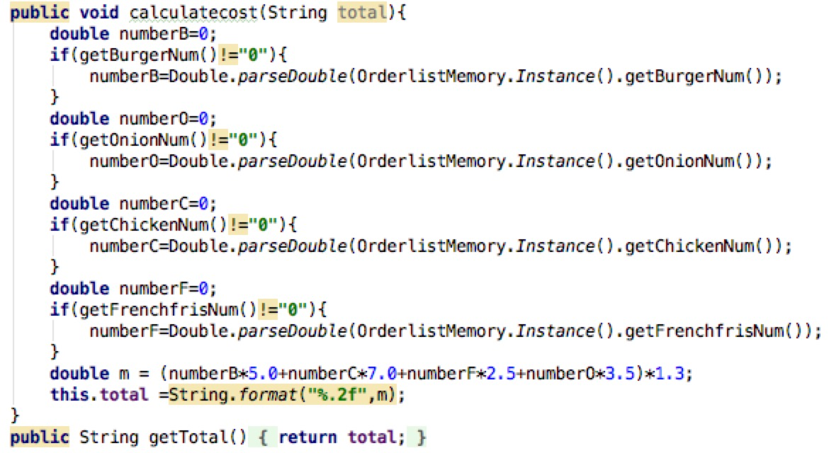
3
CLIENT PART – Place order
Northeastern University
5) Check Your Cart/Change your order:
Calculate the cost for the customer
1. Get the value from the OrdelistMemory class
2. Change the data type from String to double
3. Calculate the cost and keep two decimal places

Slide 17
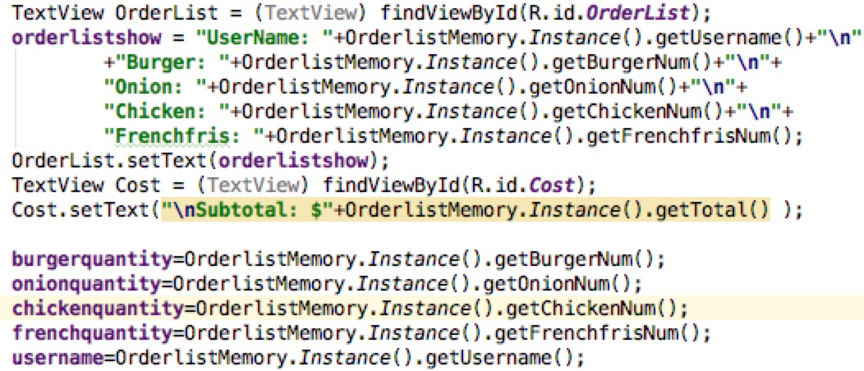
3
CLIENT PART – Place order
Northeastern University
5) Check Your Cart/Change your order:
1. Get the values from the OrdelistMemory, and display them in the textview

Slide 18
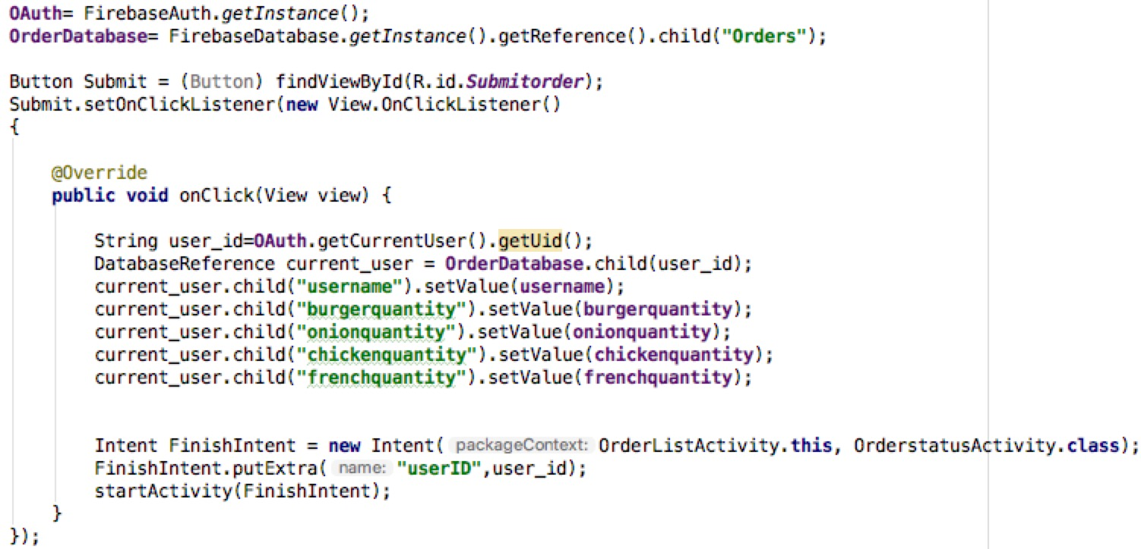
3
CLIENT PART – Place order
Northeastern University
6) Upload the Order to the online database:
1. Define user permission as a customer and get the instance of the database
Read and Write data are based on the “getReference()” function
2. Use “getUid()” function to get the current User-ID and build a new folder with the current User-ID
3. Use “setValue()” function to write data in the database
4. Create a new Intent to OrderstatusActivity and save the current User-ID as a key

Slide 19
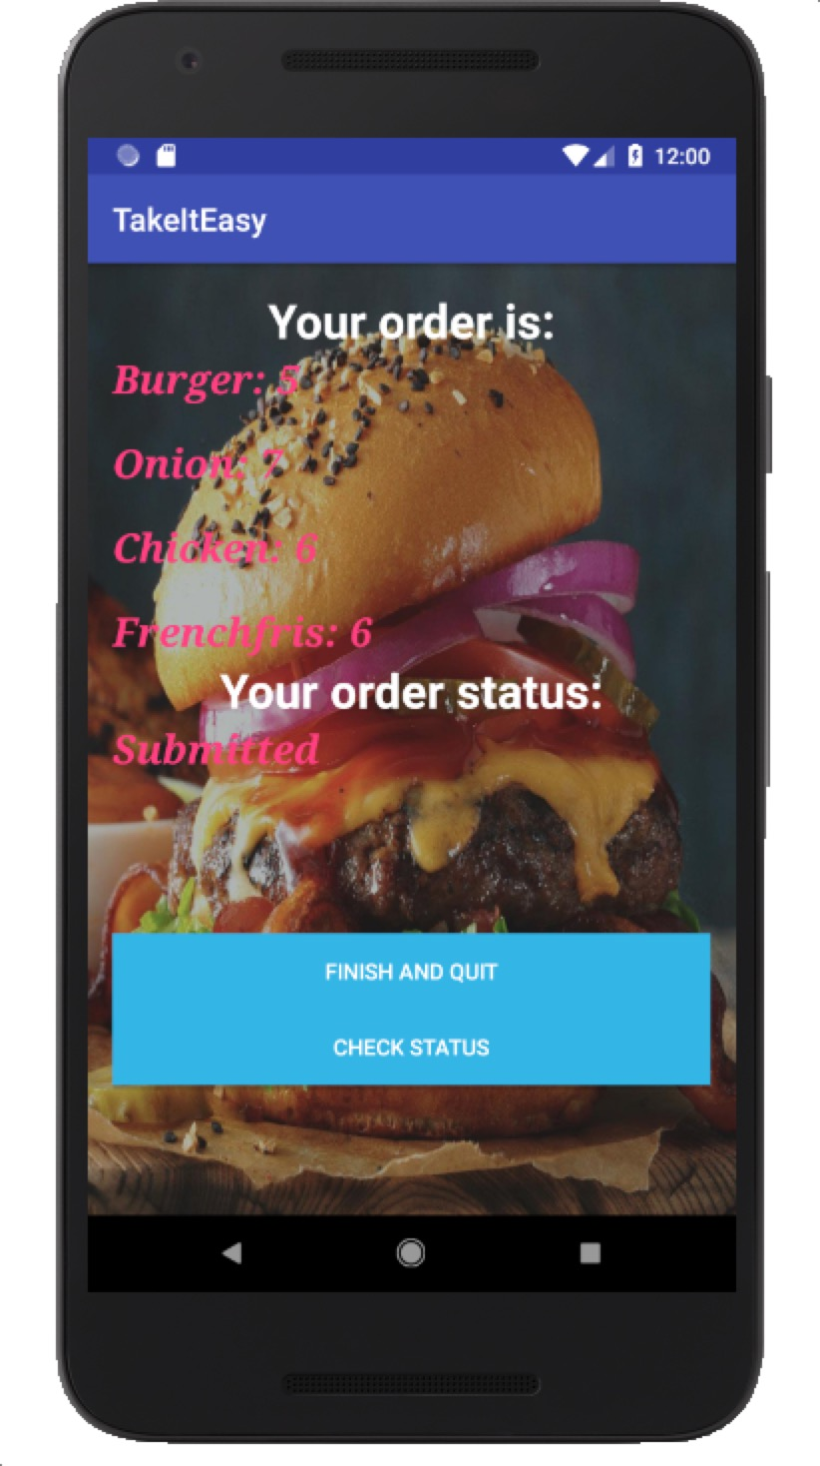
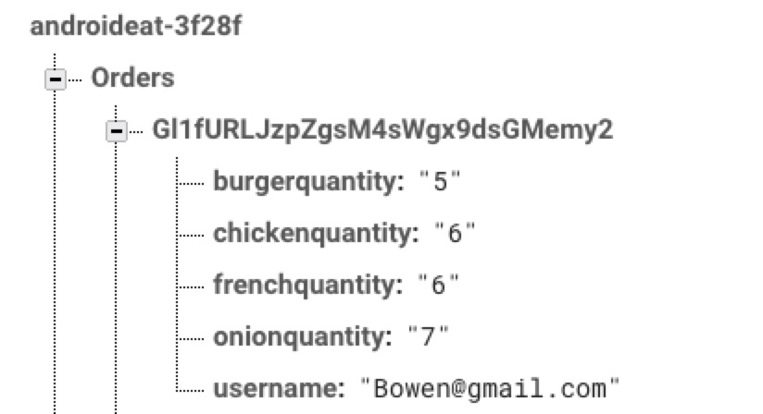
3
CLIENT PART – Place order
Northeastern University
6) Upload the Order to the online database:
Check your order from the google firebase
The name of the database
Order table to save the order information
The customer-ID
It is created by the firebase automatically
Your order information
The quantity for each item and username

Slide 20
Northeastern University
4
SERVER PART

Slide 21
4
SERVER PART
Northeastern University
STEPS:
Get the quantity of each menu item ordered by the customer.
Read from inventory and do necessary changes in the kitchen quantities.
Send order submitted notification.
After some period change the order status to preparing and send notification.
After preparing change status to ready for pickup and send notification.
Read from inventory every hour.
SPECIAL CASE : If quantity of items in kitchen reaches zero, force read from inventory.
SPECIAL CASE: If item in inventory is zero or not available ask for partial order. If user selects yes continue with partial order. I f user selects no logout and navigate back to the login screen.

Slide 22
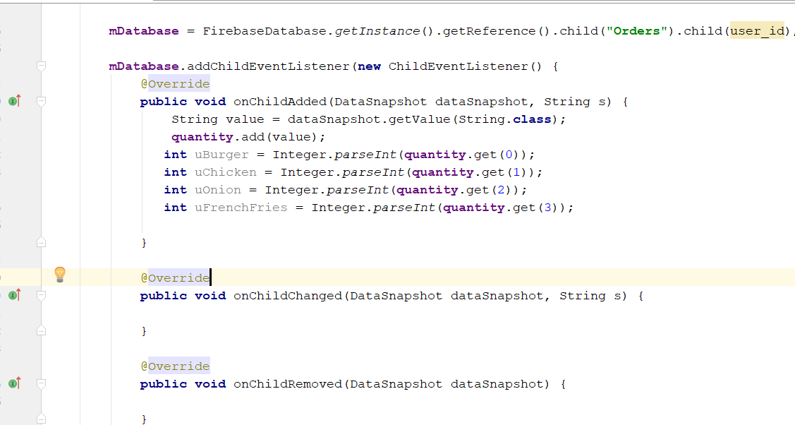
4
SERVER PART
Northeastern University
1) Get the User Menu Items:

Slide 23
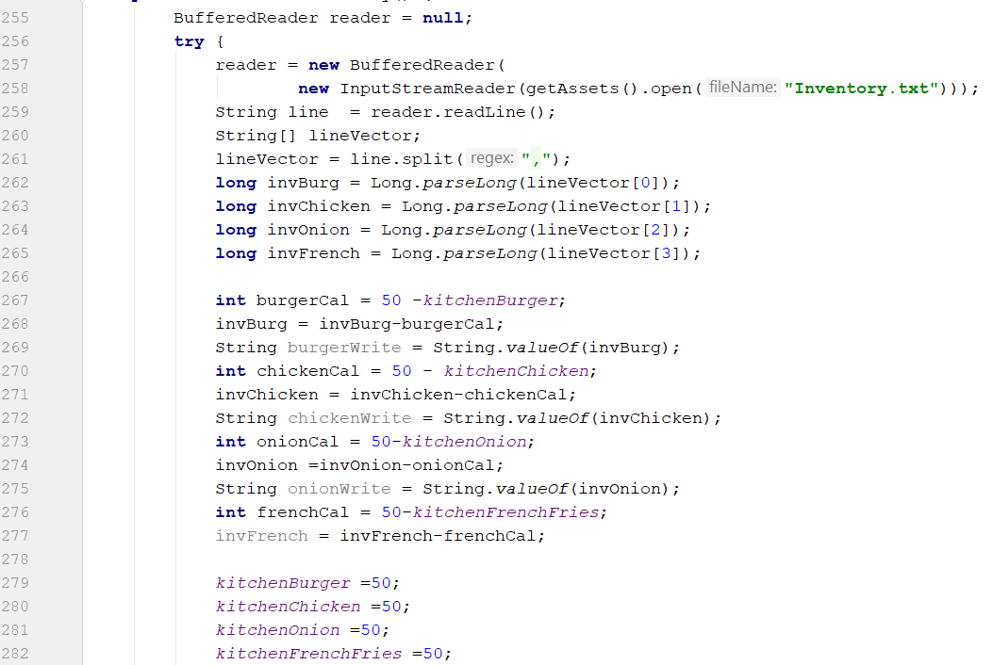
4
SERVER PART
Northeastern University
2) Read from Inventory:

Slide 24
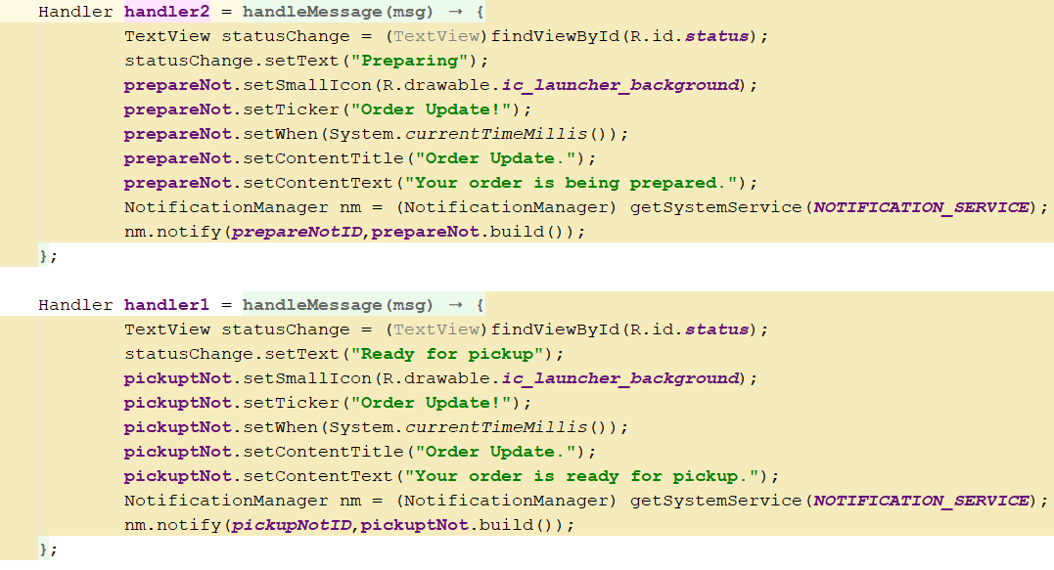
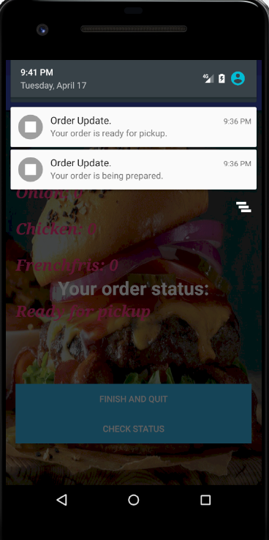
4
SERVER PART
Northeastern University
3) Send Notification for Order Submitted, Preparing and Ready for Pickup:

Slide 25
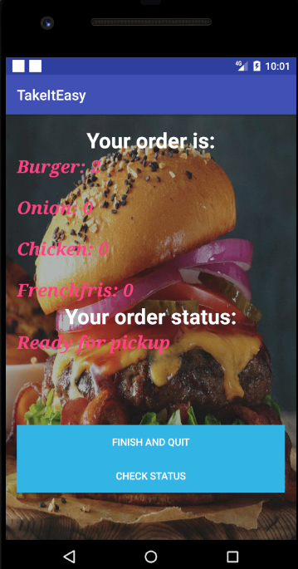
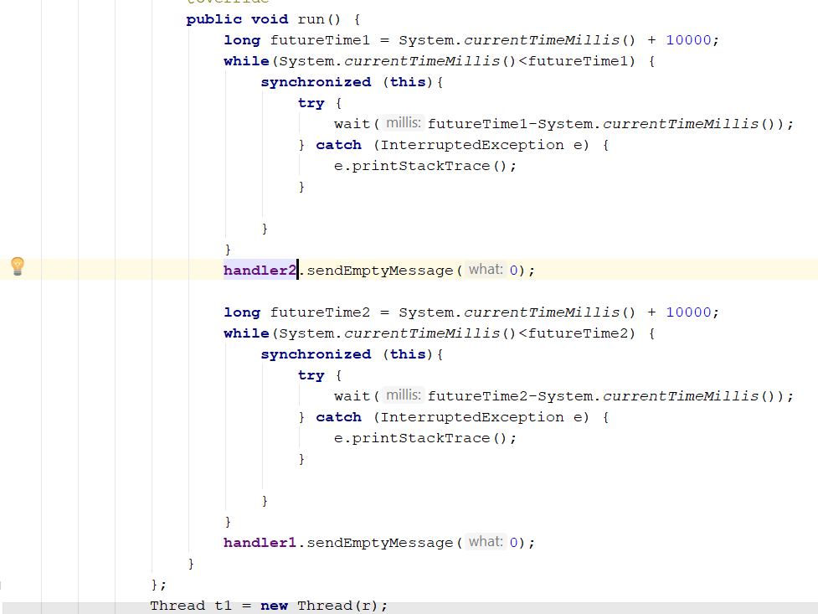
4
SERVER PART
Northeastern University
4) Change Order Status Using Threading :

Slide 26
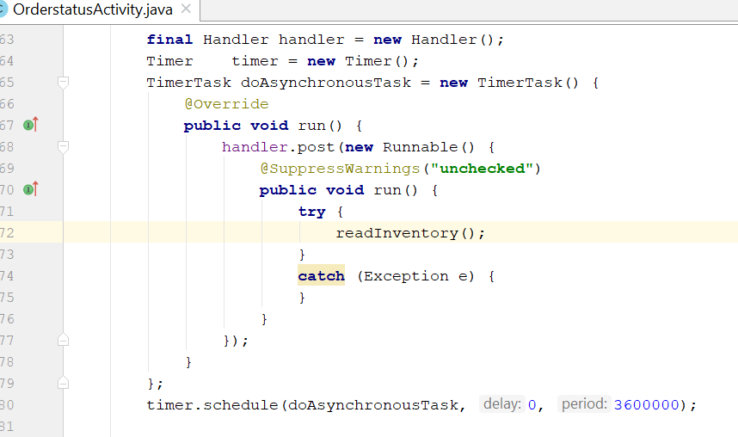
4
SERVER PART
Northeastern University
5) Inventory list updates every hour:

Slide 27
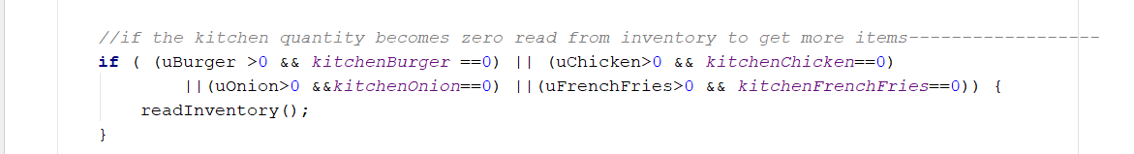
4
SERVER PART
Northeastern University
6) If Kitchen quantity becomes zero:

Slide 28
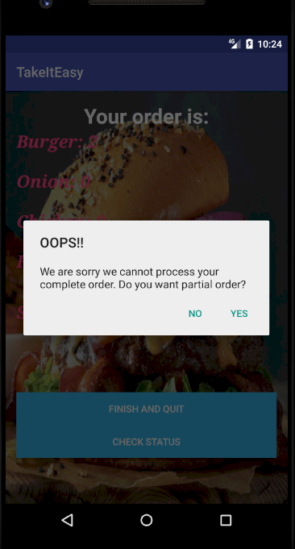
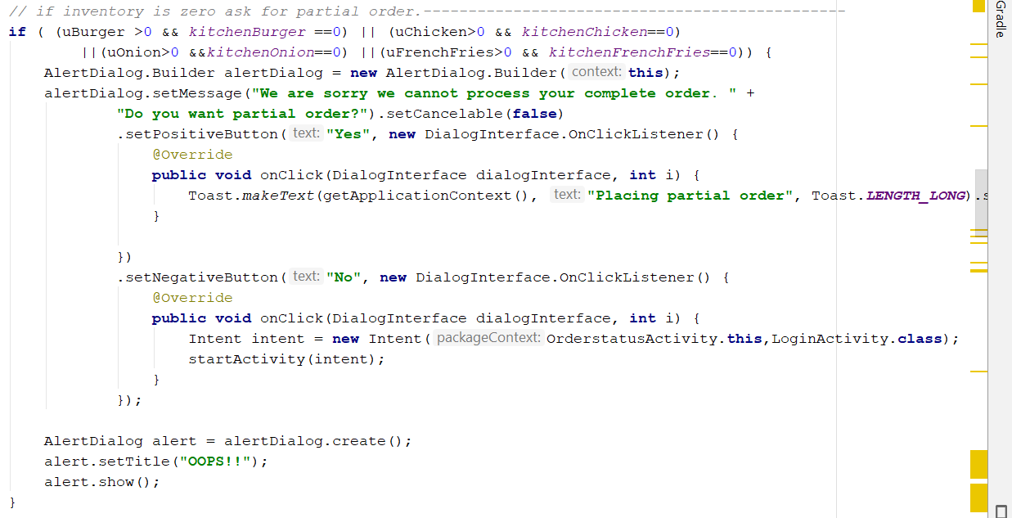
4
SERVER PART
Northeastern University
7) Special Case: Partial Order

Slide 29
Northeastern University
5
APP RUNNING

Slide 30
PROS ＡＮＤ ＣＯＮＳ ＯＦ ＩＰＤ
Identify project goals, constraints, deliverables, performance criteria, control needs, and resource requirements in consultation with stakeholders.
Basics of mobile application building and clear distinction on the client side and server side of the application.
Implement project-management knowledge, processes, lifecycle and the embodied concepts, tools and techniques in order to achieve project success.
Team-building skills required to support successful performance.
Learning Outcomes

Slide 31
Client Side
Login Process
Order and collection of order.
Database
Login Credentials
Order database
Server Side
Order Retrieval
Order Processing

Slide 32


